Slide 1
Exploring The Link Between Education and Career Success Alexander Boyd IS219 Spring 2025 Data Story Application Project

Slide 2
Essential Question: How do the choices made in one's academic journey impact their career outcomes? Background:
In the age of information, the professional landscape has seen much change in the way skills and knowledge are passed on.
In many fields, especially those centered around technology, education is no longer the only ticket into the professional world.
There are many who believe academia to be optional for entry. In my project, I seek to take an objective look at the data and come to a conclusion on whether or not school is the be-all, end-all for career success.

Slide 3

IDE Setup

Slide 4
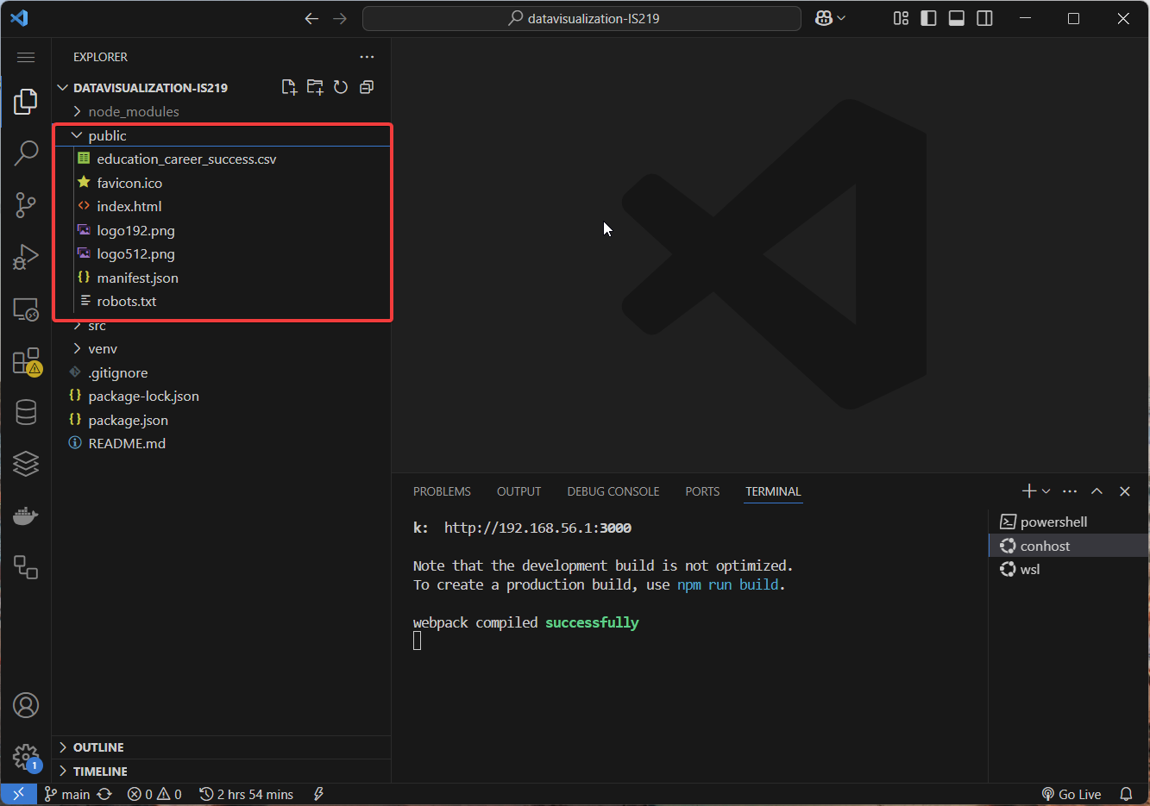
Public
My main folder (as shown on the right) is the directory where all my publicly accessible elements are kept.
These are elements that can be accessed by the web browser when the application is run. This of course, includes our dataset.

Slide 5
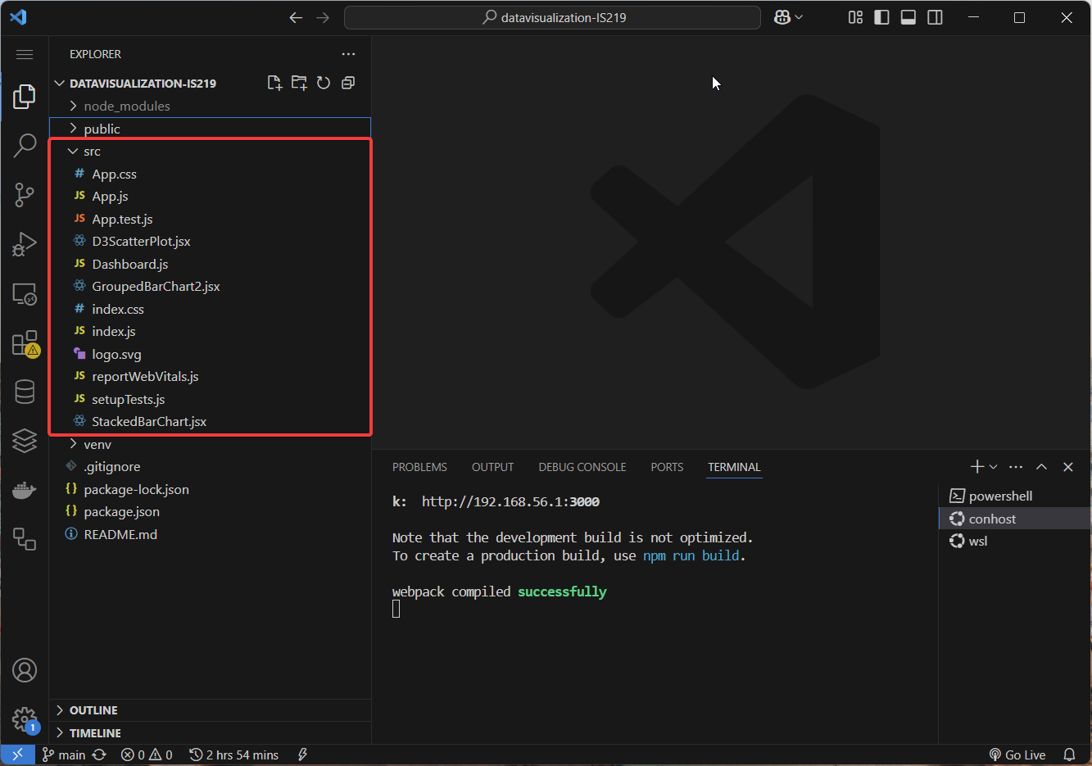
src
My src folder (as shown on the right) is the directory that contains all of my code and my react elements.
This is where I’ve stored all the files that generate the application. These are executed in the background and produce a webpage we can interact with.

Slide 6

The Application

Slide 7
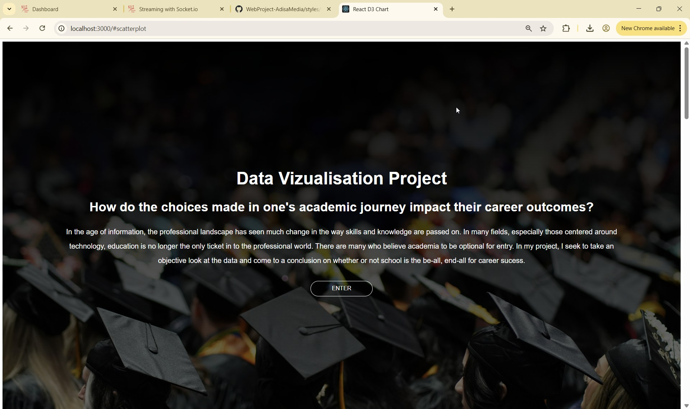
Homepage
I created this using html and CSS. This is a landing page that introduces the project and the essential question, giving a brief description.
There is a call to action which links to the rest of the page.

Slide 8
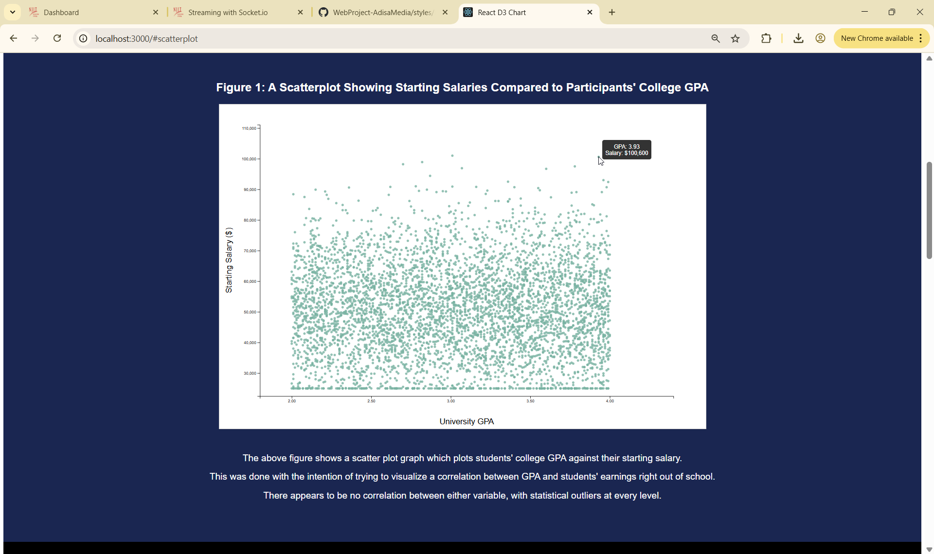
Figure 1
I created this using D3’s visualization library. This was created using Dataset 1.
The figure shows a scatter plot graph which plots students' college GPA against their starting salary. The graph uses tooltip to make it interactive, showing GPA and salary upon hovering.
This was done with the intention of trying to visualize a correlation between GPA and students' earnings right out of school.

Slide 9
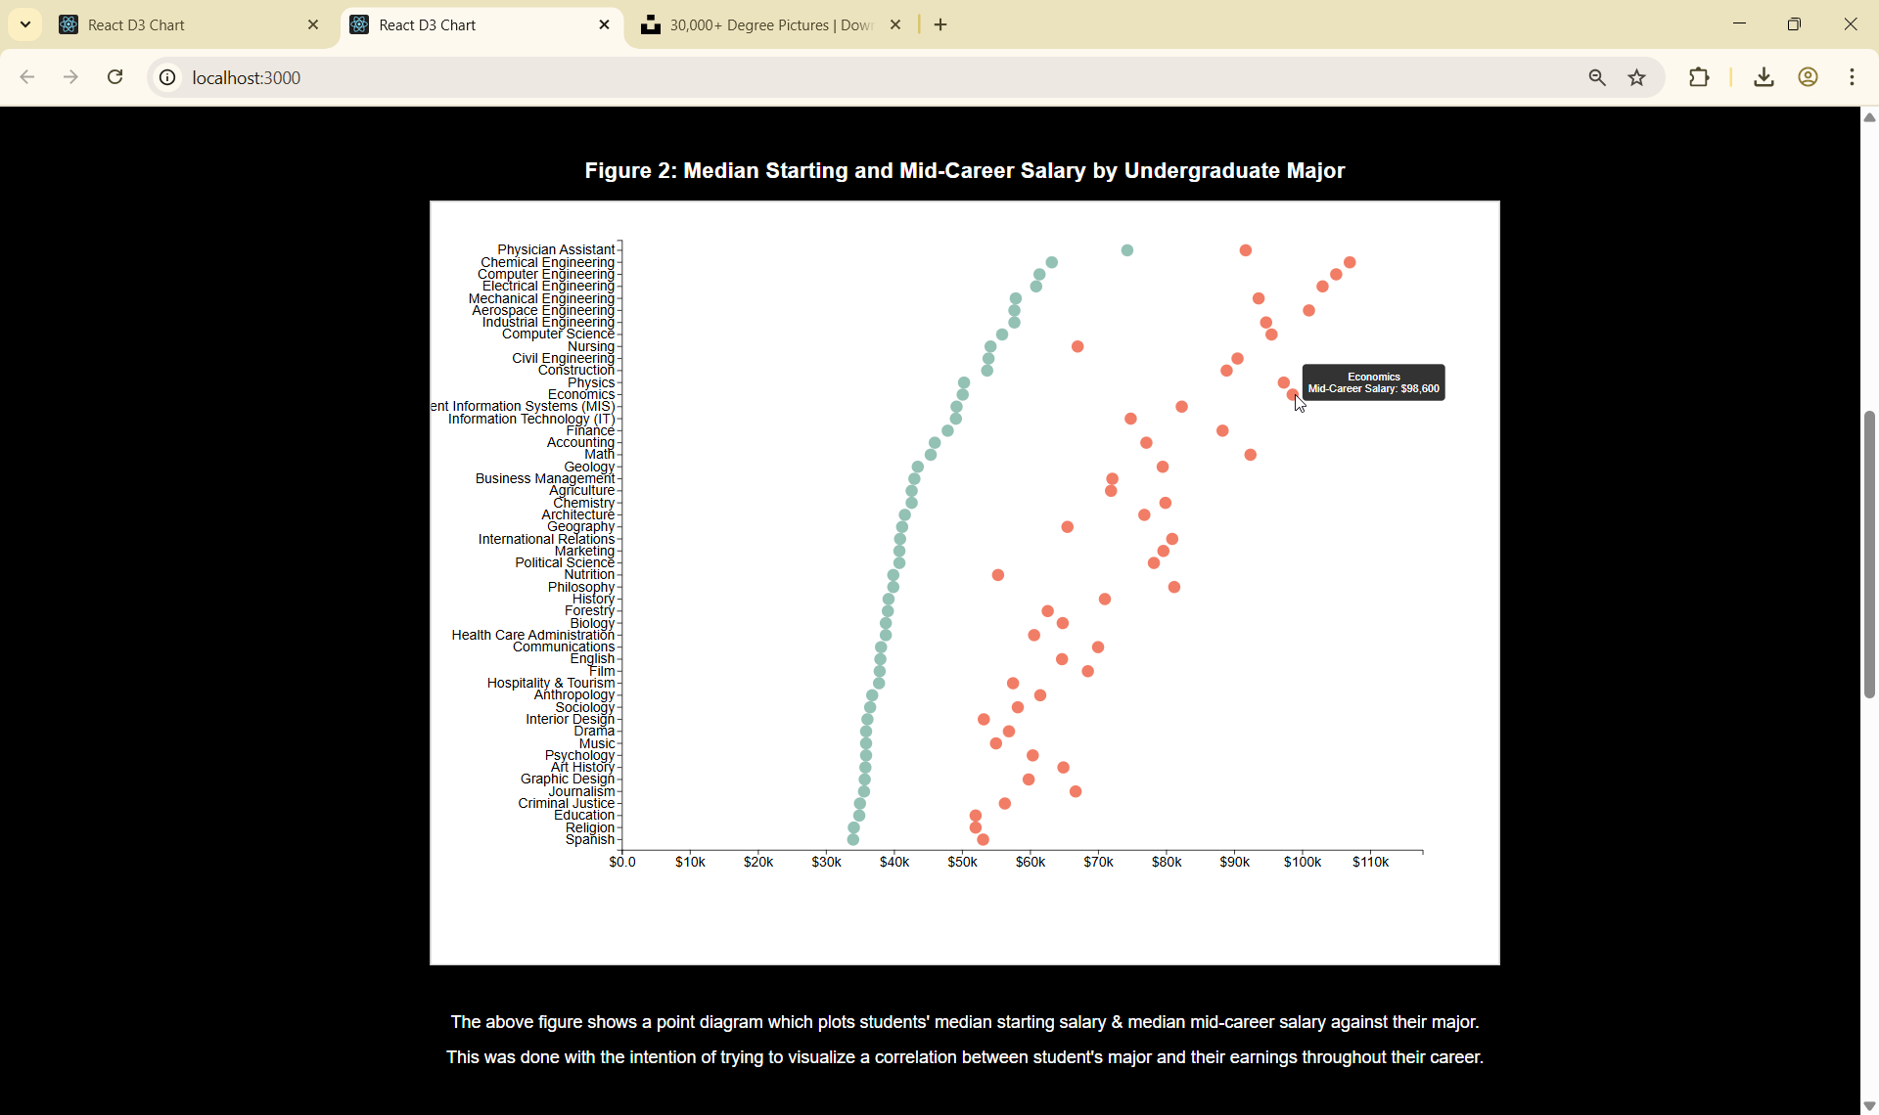
Figure 2
I created this using D3’s visualization library. This was created using Dataset 2.
The figure shows a point diagram which plots students’ major against their starting salary as well as their mid career salary. The graph uses tooltip to make it interactive, showing major and salary upon hovering.
This was done with the intention of trying to visualize a correlation between major and students' earnings.

Slide 10
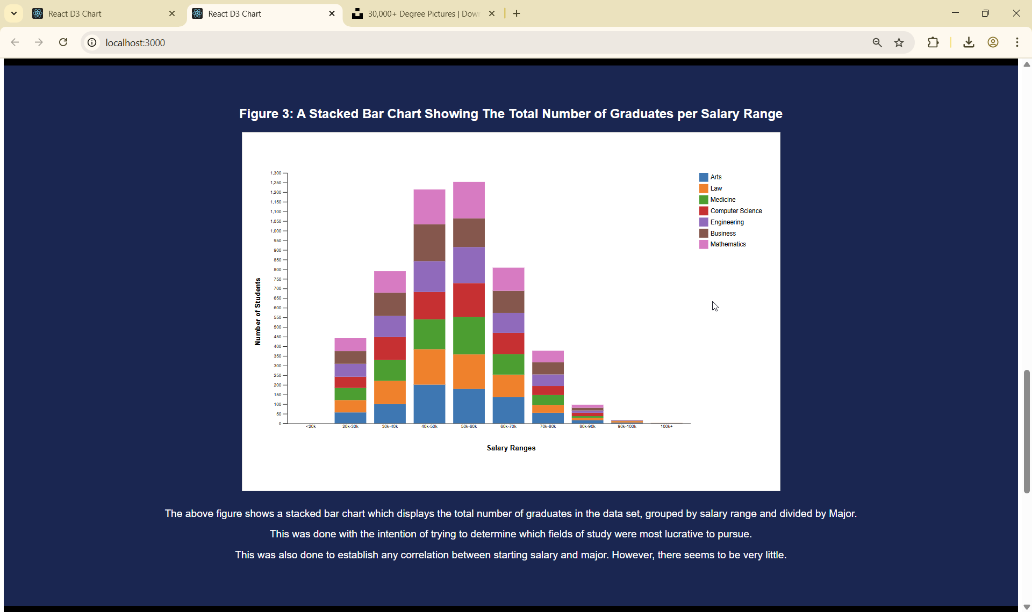
Figure 3
I created this using D3’s visualization library. This was created using Dataset 1.
The figure shows a stacked bar chart which displays the total number of graduates in the data set, grouped by salary range and divided by Major. The graph uses tooltip to make it interactive, showing major and salary upon hovering.
This was done with the intention of trying to determine which fields of study were most lucrative to pursue.

Slide 11
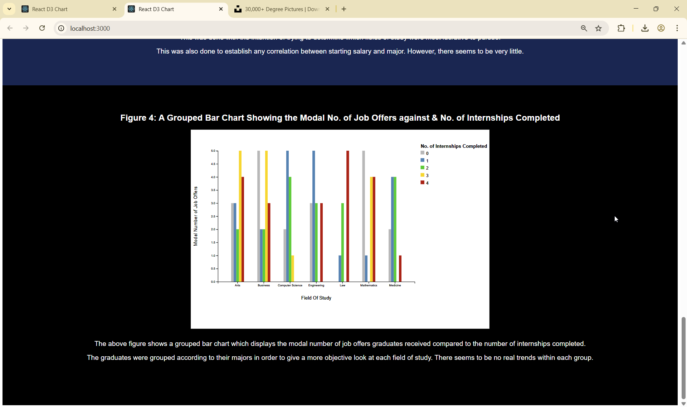
Figure 4
I created this using D3’s visualization library. This was created using Dataset 1.
The figure shows a grouped bar chart which displays the modal number of job offers graduates received compared to the number of internships they had completed.
The graduates were grouped according to their majors in order to give a more granular & objective look at each field of study.

Slide 12
Q & A
Thank you for your time!

